Slide 1

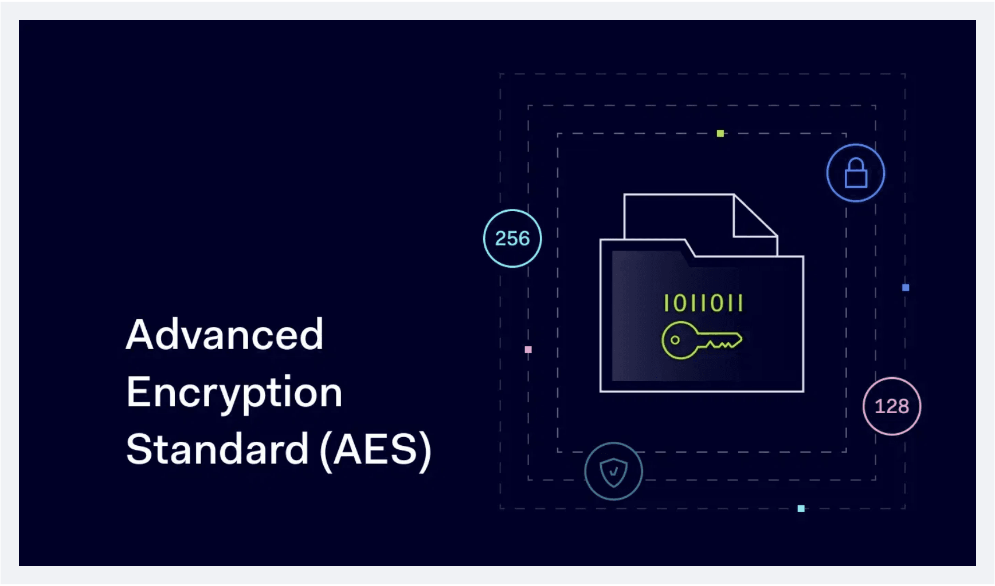
Secure File Storage Application Using AES Encryption
A Project Demonstrating Practical Cryptography Implementation
Presented by: Mohammed Alrayes Abdulaziz Fahad Alharbi Abdulaziz Saud Alharbi

Slide 2
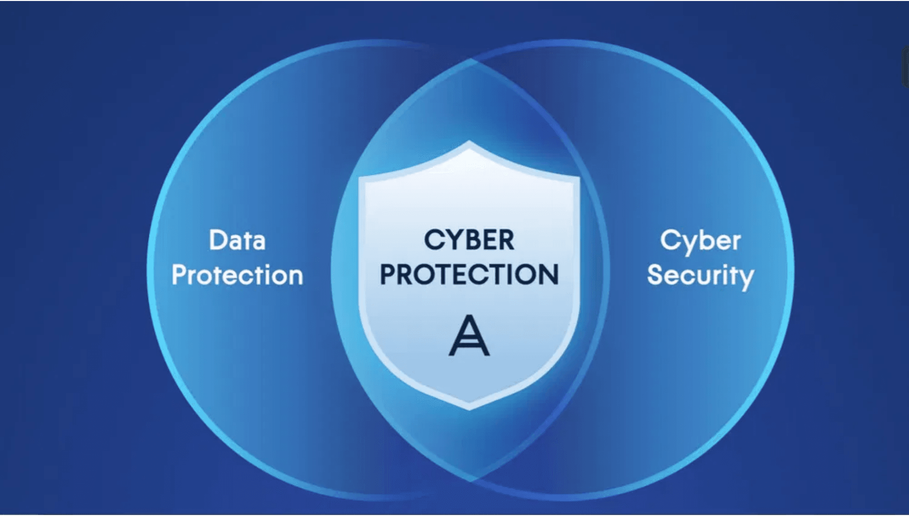
The Need for Data Protection
Data protection is a crucial requirement in modern applications due to the increasing volume of sensitive information being handled.
■
The digital landscape faces increasing risks of unauthorized access and sophisticated cyberattacks , making robust security non-negotiable.
■
The implementation of strong encryption algorithms is essential to ensure both the confidentiality and integrity of user data.
■

Slide 3
Project Goal: Secure File Storage
To enable users to securely upload, store, and retrieve encrypted files while ensuring privacy and preventing unauthorized access.
Core Technology: Advanced Encryption Standard (AES)
Implementation: Python `cryptography` library

Slide 4

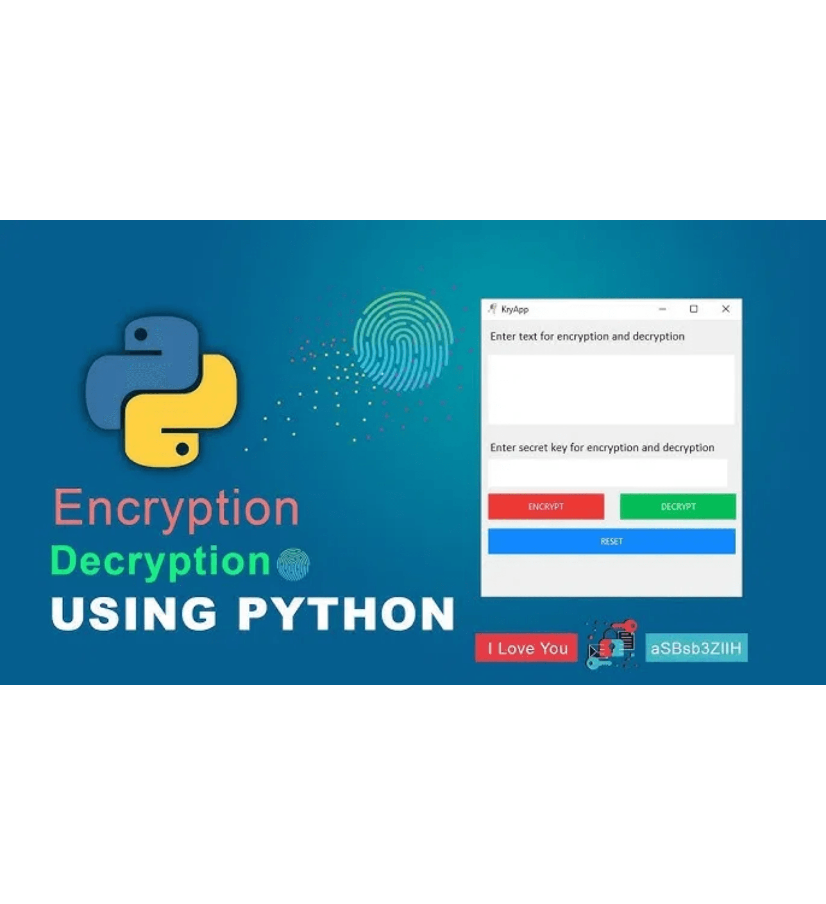
Core Application Functionalities
User Management
Create an account and log in to access secure storage.
File Handling
Upload any file type (Images, PDFs, Text documents) from the device.
Security (Encryption)
Encrypt the file using AES and store the cipher text safely.
Retrieval (Decryption)
Retrieve the encrypted file and decrypt it back to the original format.
Interface
Simple Graphical User Interface (GUI) built with Tkinter for ease of use.

Slide 5






User Interface and Authentication
User Interface (Tkinter)
User Authentication
Simple and intuitive graphical user interface (GUI).
Credentials stored securely in a JSON file (`users.json`).
Consists of a login/registration window and a file management window.
Module handles registration of new users and verification during login.
Includes buttons for uploading, encrypting, and decrypting files.
Crucial for preventing unauthorized access to encrypted files.

Slide 6

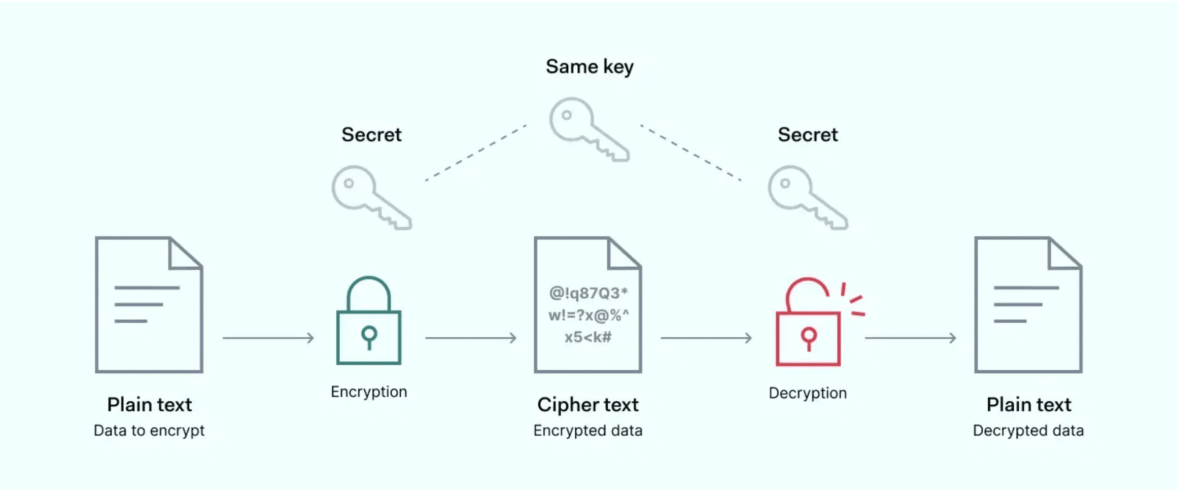



Deep Dive: AES Encryption
Encryption Standard: Advanced Encryption Standard (AES), implemented via the Python `cryptography` library.
Fernet Implementation: Uses AES-128 in CBC mode combined with HMAC for both strong confidentiality and integrity protection.
Key Management: A single symmetric key is generated and stored in a separate file (`aes.key`) for both encryption and decryption.
Storage Output: Encrypted files are saved inside the `encrypted_files` directory with the `.enc` extension.

Slide 7
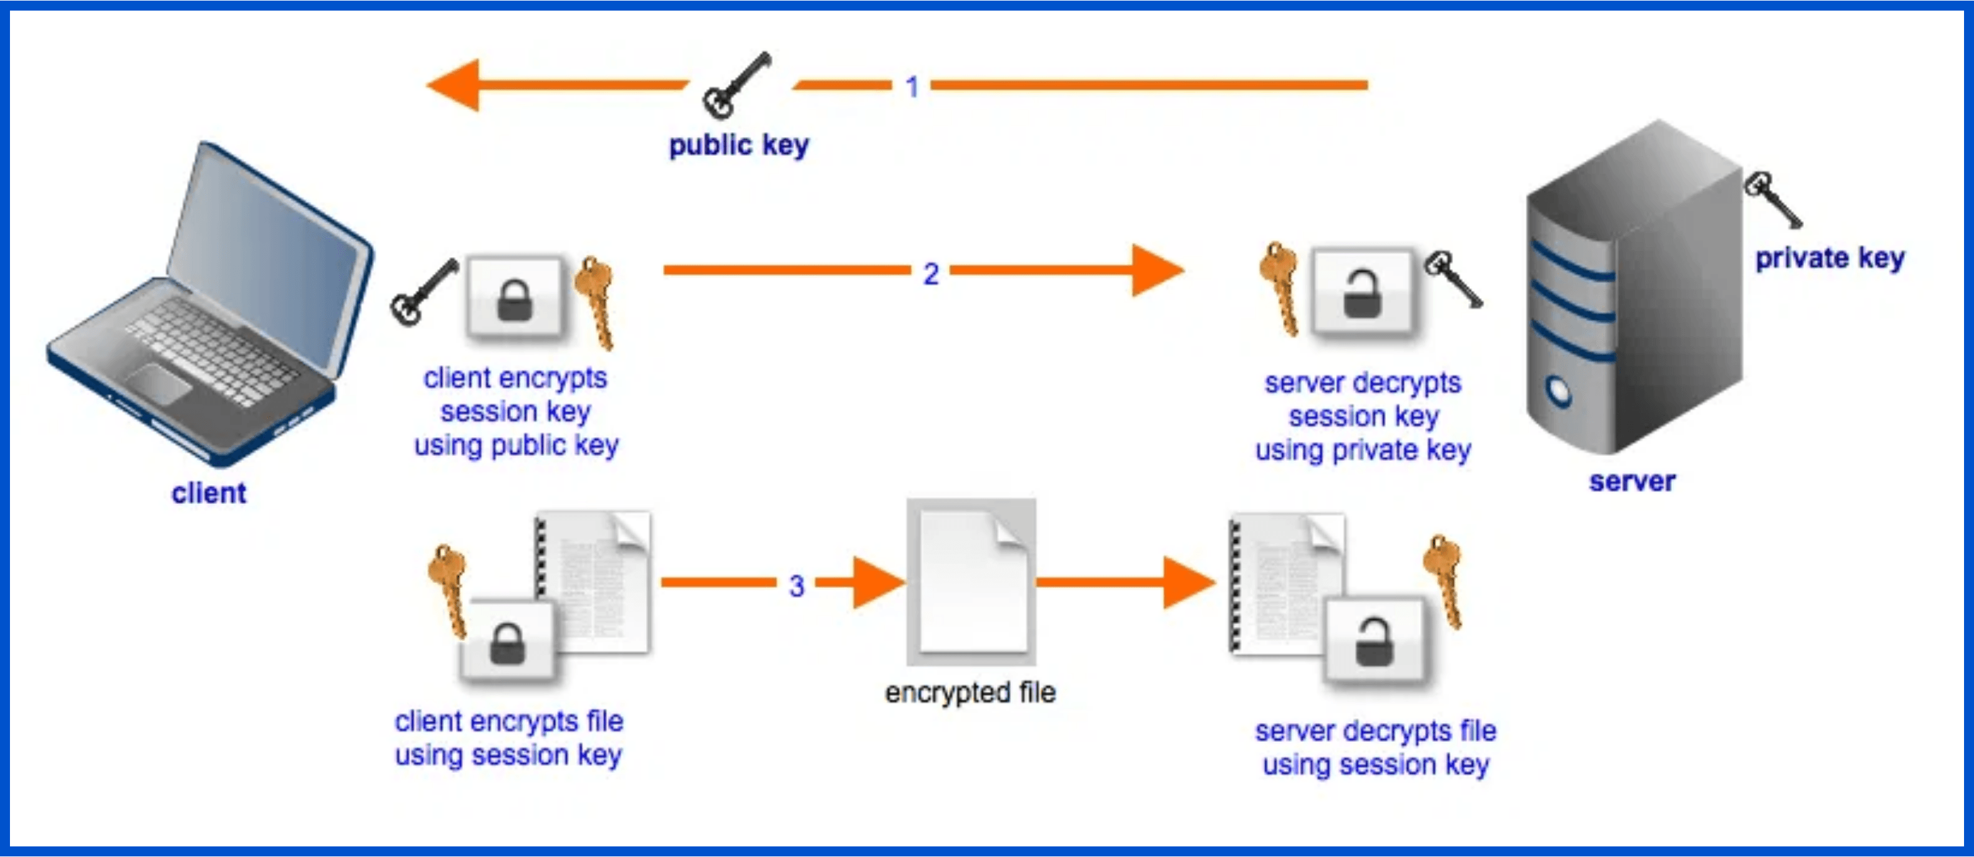

File Retrieval and Decryption
1.
User selects a .enc encrypted file from storage.
2.
Application attempts decryption using the stored aes.key.
3.
If successful, the original file is restored and saved to a user-chosen location.
Decryption Validation
Decryption fails if the file is corrupted or
the key is invalid, ensuring data
confidentiality and integrity.

Slide 8

Implemented Security Measures
Strong AES-based Encryption
Key Separation and Protection
Utilizing the Advanced Encryption Standard for robust confidentiality and data integrity.
The encryption key is stored in a separate file, preventing direct access to the key alongside the encrypted data.
Restricted Decryption Access
Secure Credential Storage
Decryption is only possible for users who possess the correct key, enforcing strict access control.
User authentication details are stored securely in a JSON file, protecting against unauthorized login attempts.

Slide 9

Development Challenges & Learnings
Understanding Fernet and AES Implementation
Learning how the Fernet library integrates AES-128 in CBC mode with HMAC for integrity required
dedicated effort.
Managing Encrypted Files
Ensuring all encrypted files were saved correctly, with proper extensions (.enc), and stored in the
designated directory.
Working with Tkinter
Handling the complexity of multiple windows, managing file dialogs, and ensuring a smooth user
experience within the GUI.
Decryption Validation
Implementing robust checks to handle decryption failures when files were corrupted or the
encryption key was invalid or changed.

Slide 10




Project Conclusion
Strong File Protection
Functional Authentication
Clean User Interface
Successfully integrated robust
Provided a simple and clean GUI
AES-based encryption into a real-
Developed a fully functional and
for an enhanced user experience.
world application.
secure user authentication
system.
The project highlights the critical importance of cryptography in protecting user data and securing digital environments.

Slide 11
THANK YOU
Questions & Discussion
Mohammed Alrayes | Abdulaziz Fahad Alharbi | Abdulaziz Saud Alharbi

